Slide 1

BTC Trading Signal Generation: Integrating Market Microstructure and Technical Indicators
BO-LING TSENG YUN-TSE LAN
Aye Mya Thandar
(314707007) (112705059)
(313712020)

Slide 2
Agenda
Motivation
Introduction
Data
Benchmark model
Study plan
result
IDA Template

Slide 3
Motivation

Slide 4
Project Motivation
Bitcoin market, is highly volatile but full of trading opportunities.
Traditional regression models can't capture complex, nonlinear market behaviors.
We use machine learning with order book imbalance and technical indicators to predict short-term returns.
Dynamic stop-loss and take-profit rules optimize the Sharpe ratio , balancing profit and risk.
Our goal is to build a robust that outperforms traditional models and adapts to market volatility.

Slide 5
Introduction

Slide 6
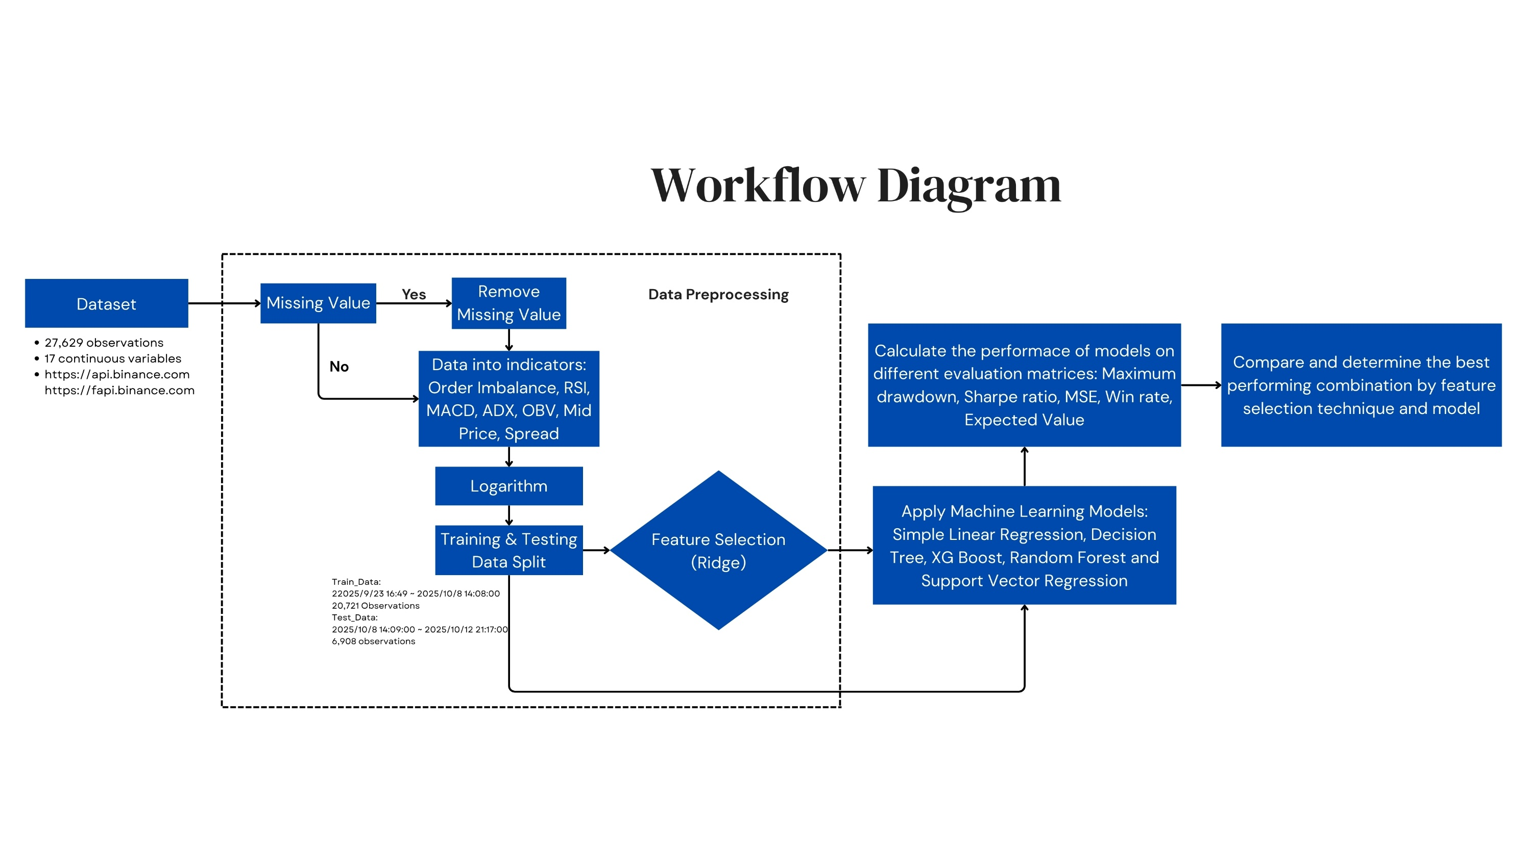
Overview Study Plan
IDA Template

Slide 7
Trading strategy
We use the following model to predict future returns, y_pred:
1. Linear Regression (LR)-----------Benchmark model
2. Support Vector Regression (SVR)
3. XGBoosting (XGB)
4. Decision Tree (DT)
5. Random Forest (RF)

Slide 8
Trading strategy
Trading Logic
Trading decisions were derived from the predicted return 𝑦_pred ​relative to a transaction-cost threshold fee.
Long Entry → ​
Short Entry →
𝑦_pred > fee
𝑦_pred < −fee
IDA Template

Slide 9
Trading strategy
The strategy uses ATR-based dynamic thresholds to manage each open position.
Fixed ATR Multipliers, TP, SL:
take profit: position’s return > TP × ATR%[t]
stop-loss: position’s return < −SL × ATR%[t]
Parameter Optimization & Evaluation:
A grid search is performed over TP and SL in the range [0.5, 3.0] with increments of 0.1.
Backtest on the training set.
Maximizes the annualized Sharpe ratio is selected.
IDA Template

Slide 10
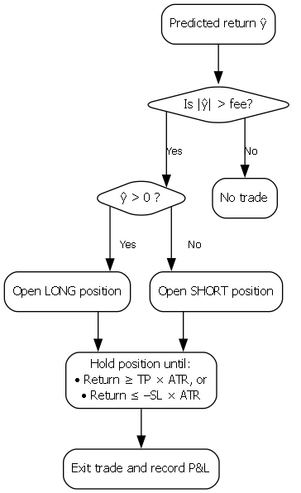
IDA Template

Slide 11
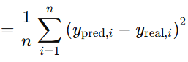
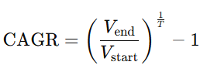
Performance Measurements
Sharpe Ratio = (annual return – risk free rate) / annual_volatility
Maximum Drawdown = (maximum cumulative return - cumulative return)/ maximum cumulative return
Win Rate = Number of winning trades / total number of trades
Expected Value = p(win)*u(win)+p(loss)*u(loss)
MSE (Mean Squared Error)
Compound Annual Growth Rate, CAGR
IDA Template

Slide 12
Data

Slide 13
Data
1-minute high-frequency data for the BTC/USDT trading pair.
Collected from the Binance Exchange public API.
Order book depth
K-line data (OHLCV)
futures market open interest
IDA Template

Slide 14
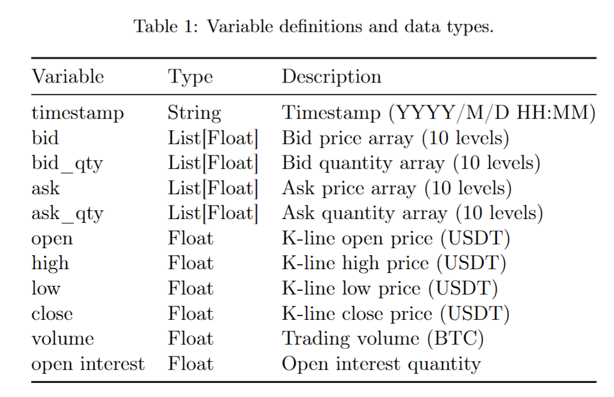
Data
IDA Template

Slide 15
Data
Training set: 2025/9/23 16:49 ~ 2025/10/8 14:08:00
Total: 21,440 data
Test set: 2025/10/8 14:09:00 ~ 2025/10/12 21:17:00
Total: 6,189 data
IDA Template

Slide 16
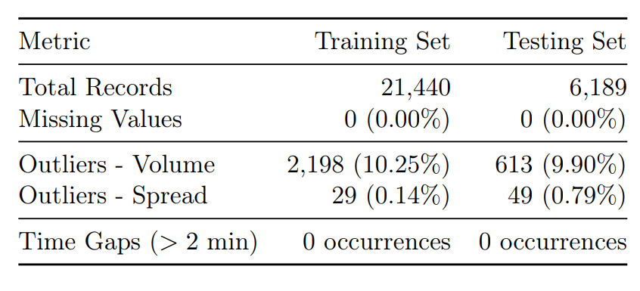
EDA Outcome and Analysis
Data Quality Assessment
No Missing Data
Volume outliers reflecting the fat-tailed, impulse-like nature of cryptocurrency trading activity rather than data errors.
IDA Template

Slide 17
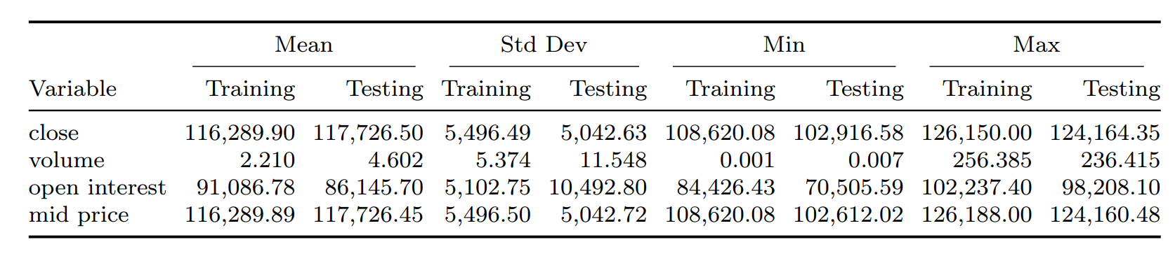
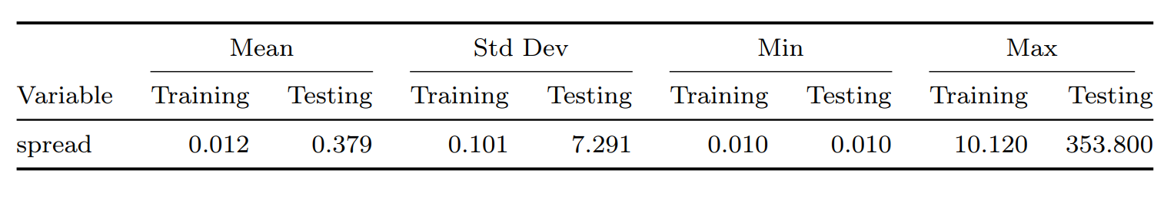
EDA Outcome and Analysis
Statistics Analysis
Significant increase in average trading volume in the testing set.
Testing set exhibits extreme spread outliers (Max 353.80), indicating potential liquidity stress.
IDA Template

Slide 18
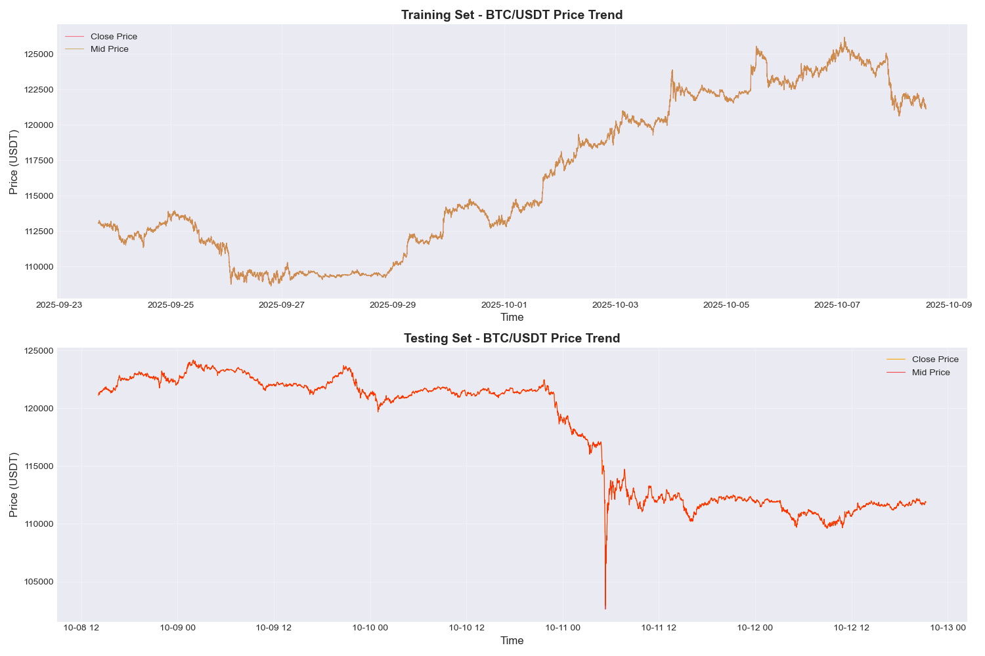
Data
IDA Template

Slide 19
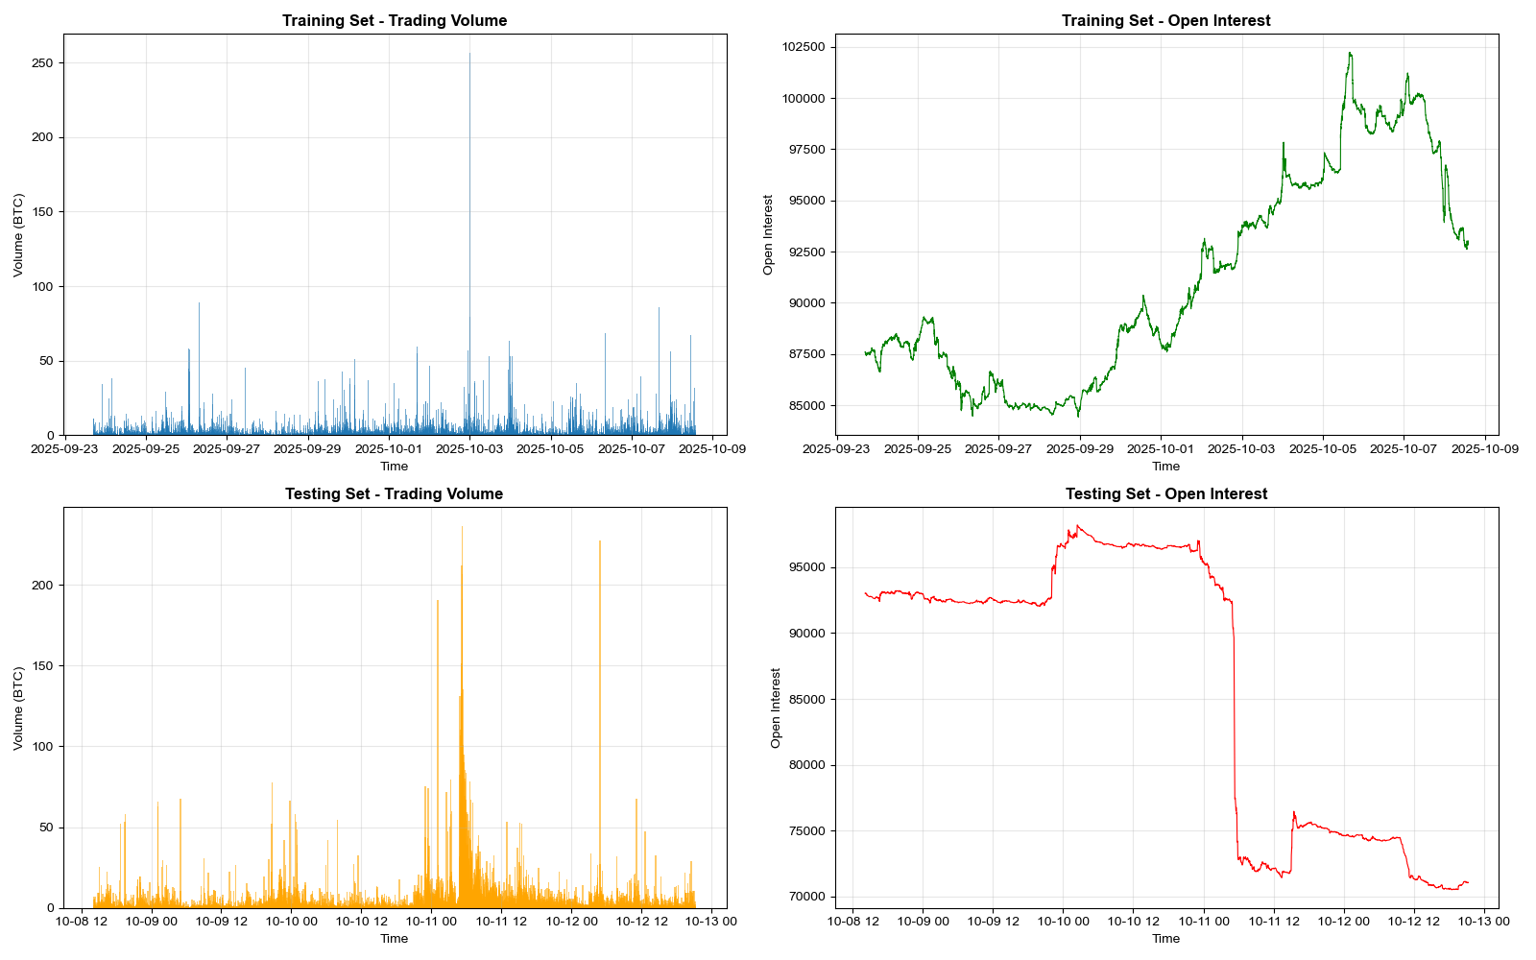
Data
Dense volume spikes and the sharp drop in Open suggesting a liquidation event.
IDA Template

Slide 20
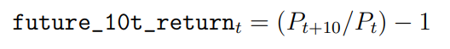
EDA Outcome and Analysis
Feature engineering
To reduce signal, the 1-minute data are resampled into 5-minute intervals.
Target: future_10t_return = 50 minutes forward return(Pₜ₊₁₀ / ​​Pₜ) − 1
Predictors: 8 price momentum features + 3 microstructure features + 5 technical/market indicators
IDA Template

Slide 21
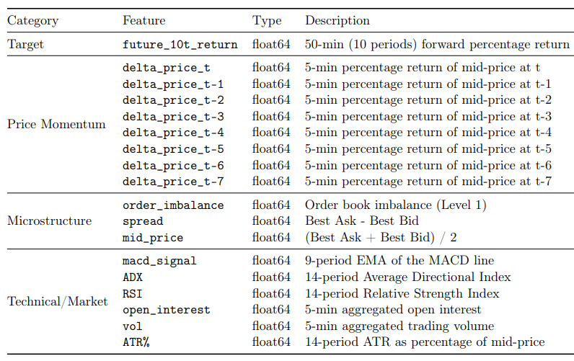
EDA Outcome and Analysis
Engineered feature definitions
The final dataset consists of one target variable and 16 predictor features.
IDA Template

Slide 22
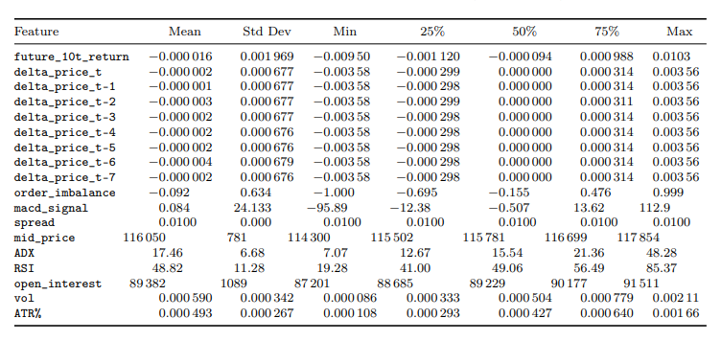
EDA Outcome and Analysis
Exploratory analysis of engineered features
IDA Template

Slide 23
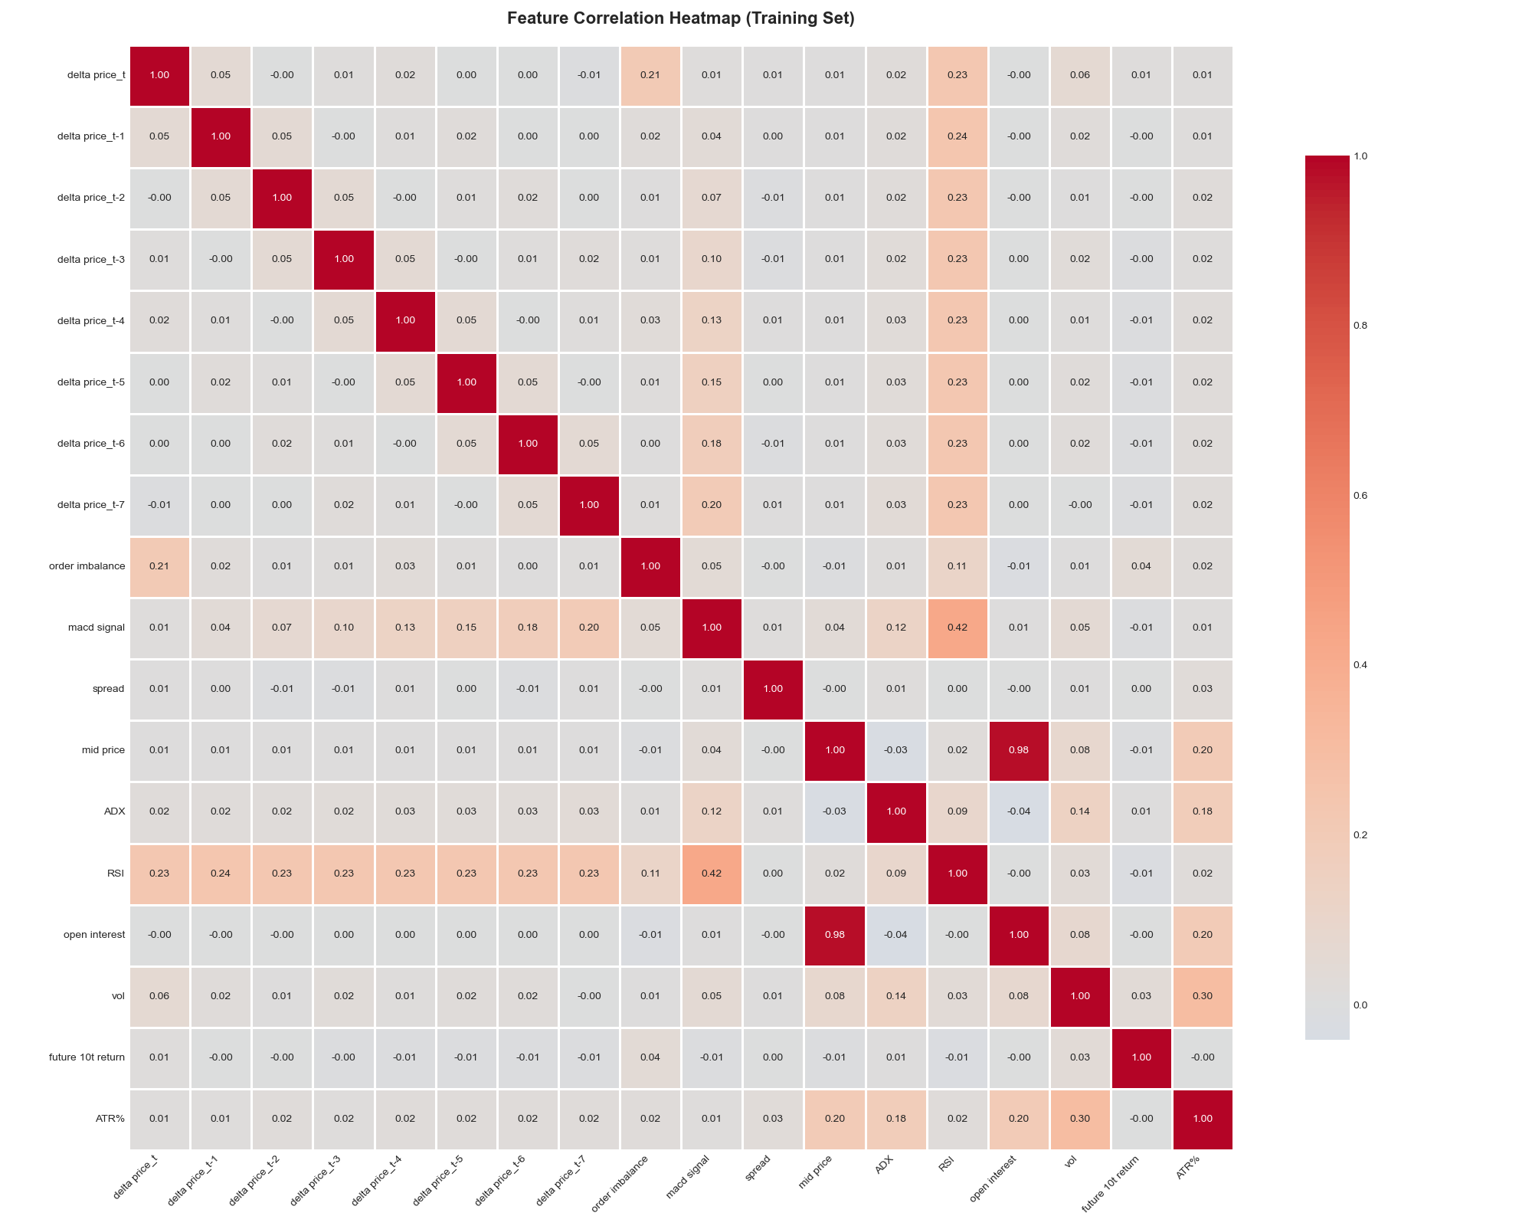
EDA Outcome and Analysis
Correlation analysis
IDA Template

Slide 24
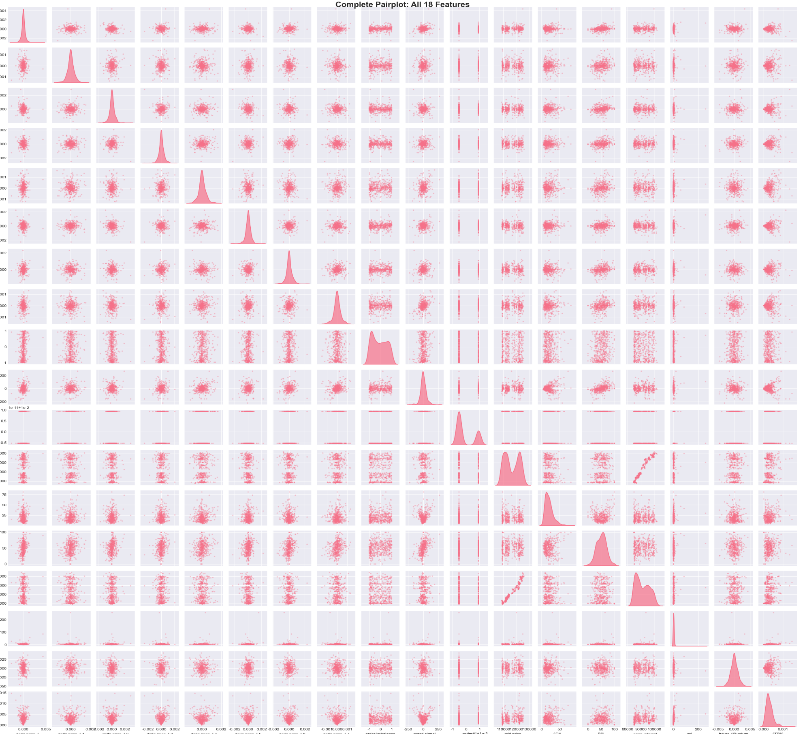
EDA Outcome and Analysis
Pairplot analysis
IDA Template

Slide 25
Benchmark model

Slide 26
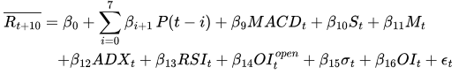
Benchmark Model
IDA Template

Slide 27
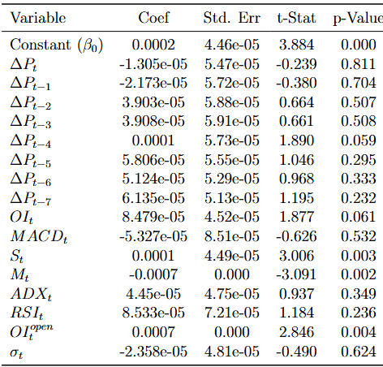
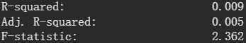
Benchmark Model
IDA Template

Slide 28
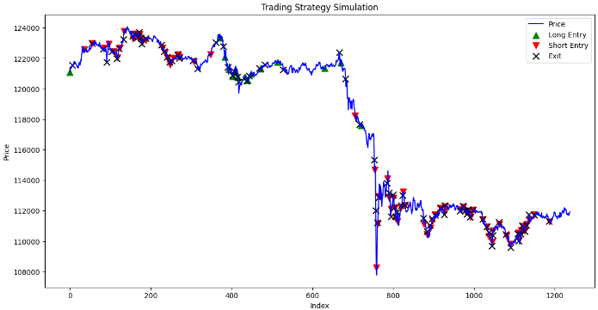
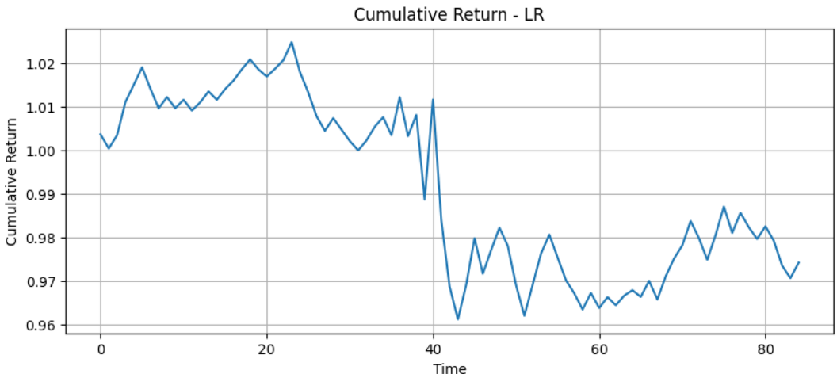
Backtest Results
Horrible!
IDA Template

Slide 29
Backtest Results
Performance Measures:
Sharpe ratio: -0.8399537070702341
Max Drawdown: 0.06197069932081422
EV per trade : 0.000285
Win rate: 0.517647
CAGR: -0.9999817
IDA Template

Slide 30
Study plan & results

Slide 31
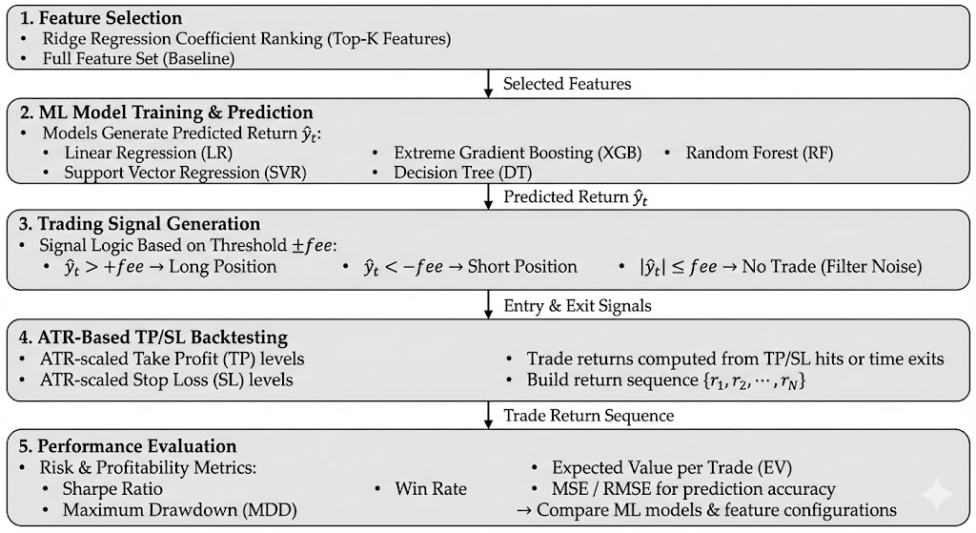
Study plan
Overall Workflow
IDA Template

Slide 32
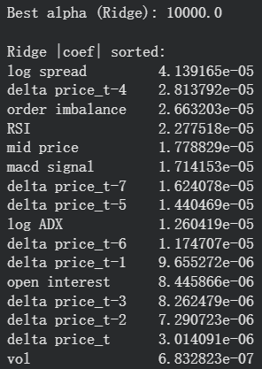
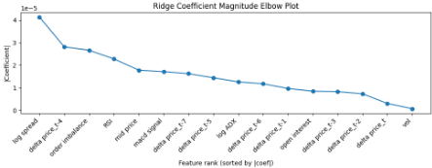
Study plan
Feature Selection: Ridge
We select k = 8
IDA Template

Slide 33
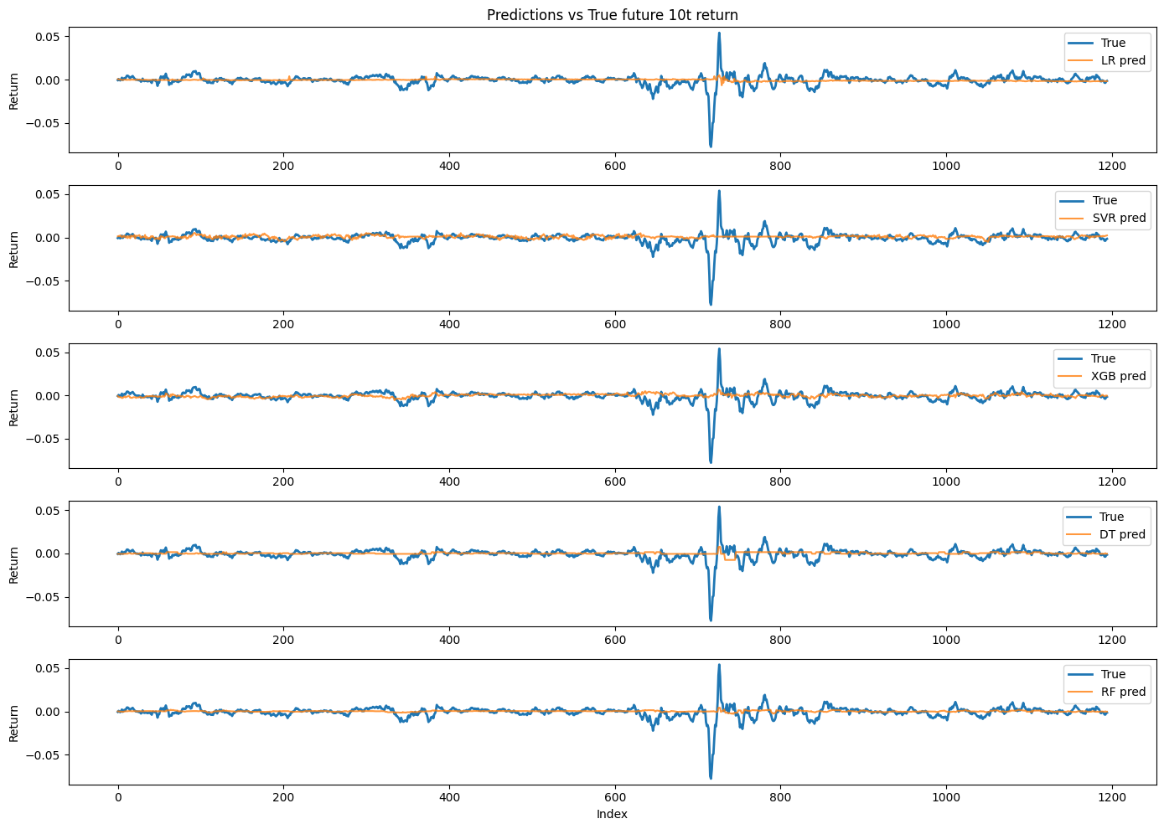
Results
y_pred V.S. y_real
Applying Models without Feature Selection
IDA Template

Slide 34
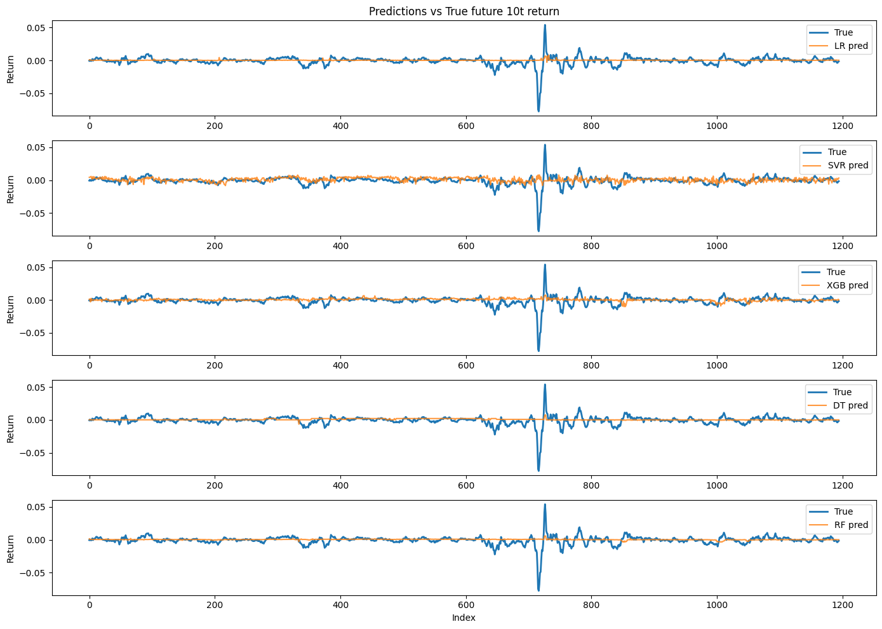
Results
y_pred V.S. y_real
Applying Models Ridge Regression
IDA Template

Slide 35
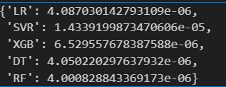
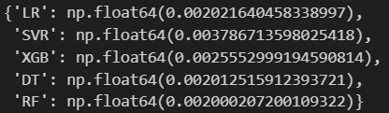
Results
MSE Results for all features:
MSE Results for ridge:
IDA Template

Slide 36
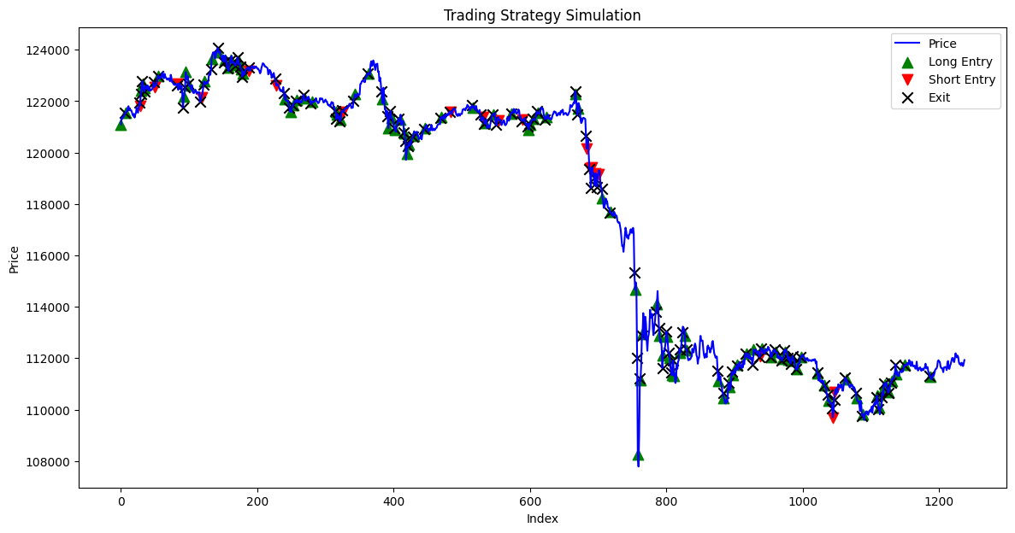
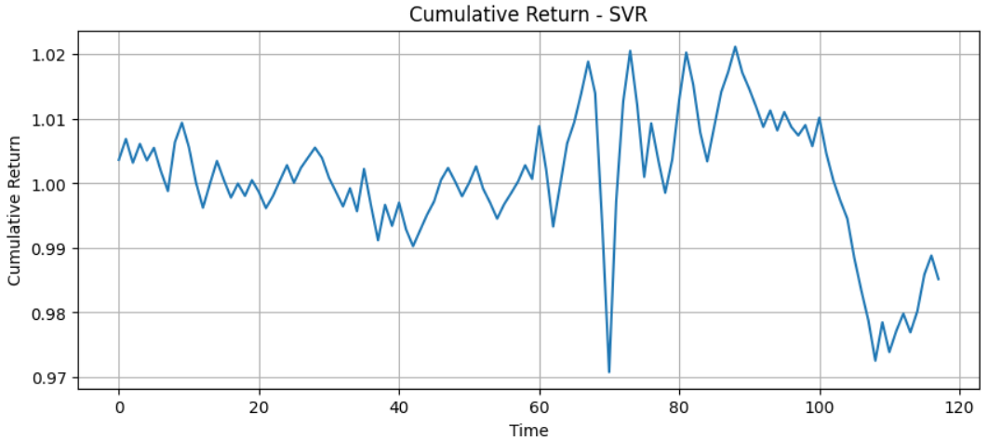
Results
SVR Trading Strategy
IDA Template

Slide 37
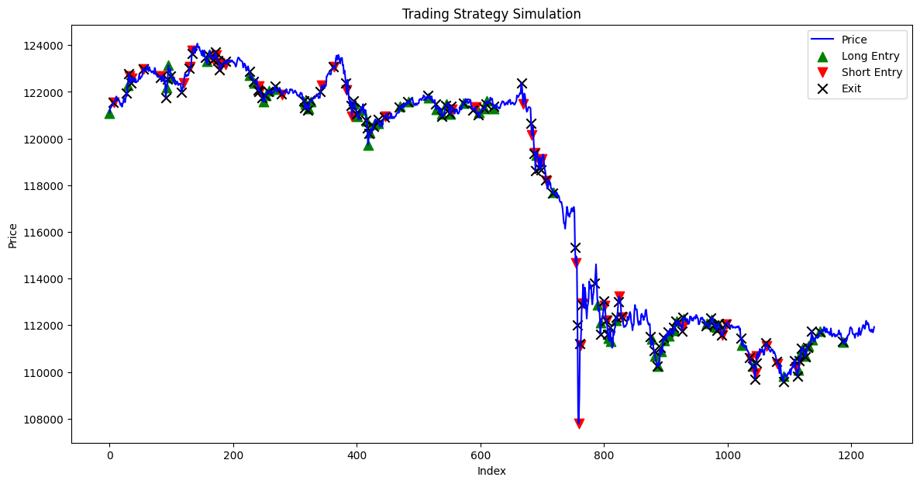
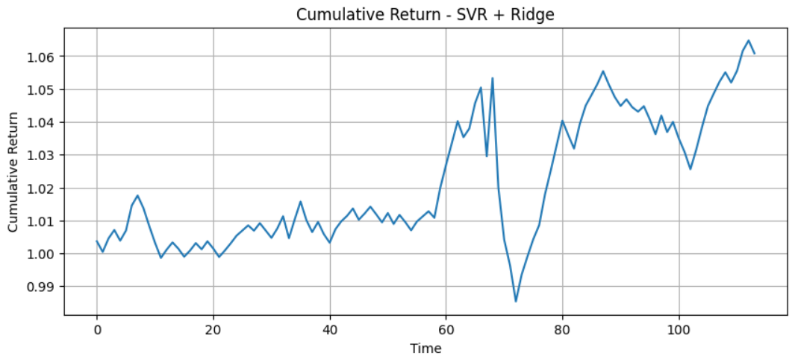
Results
SVR_Ridge Trading Strategy
IDA Template

Slide 38
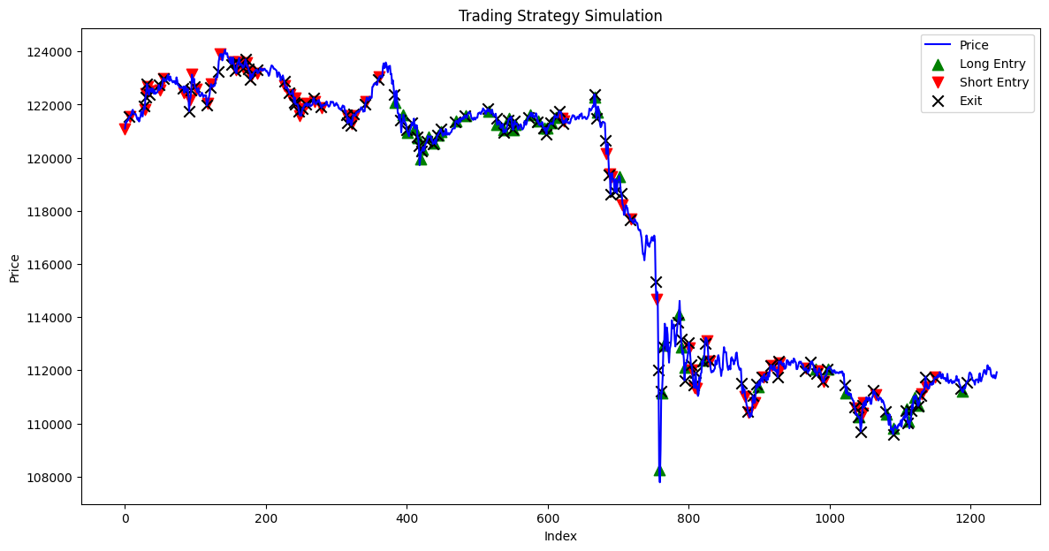
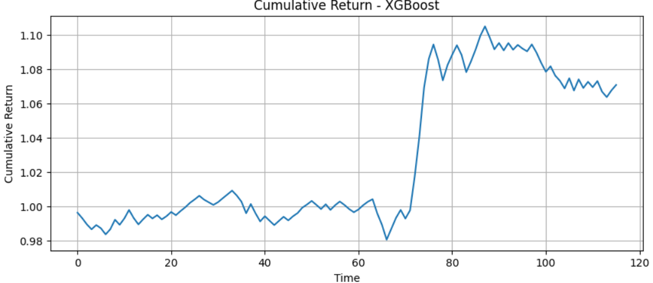
Result
XGB Trading Strategy
IDA Template

Slide 39
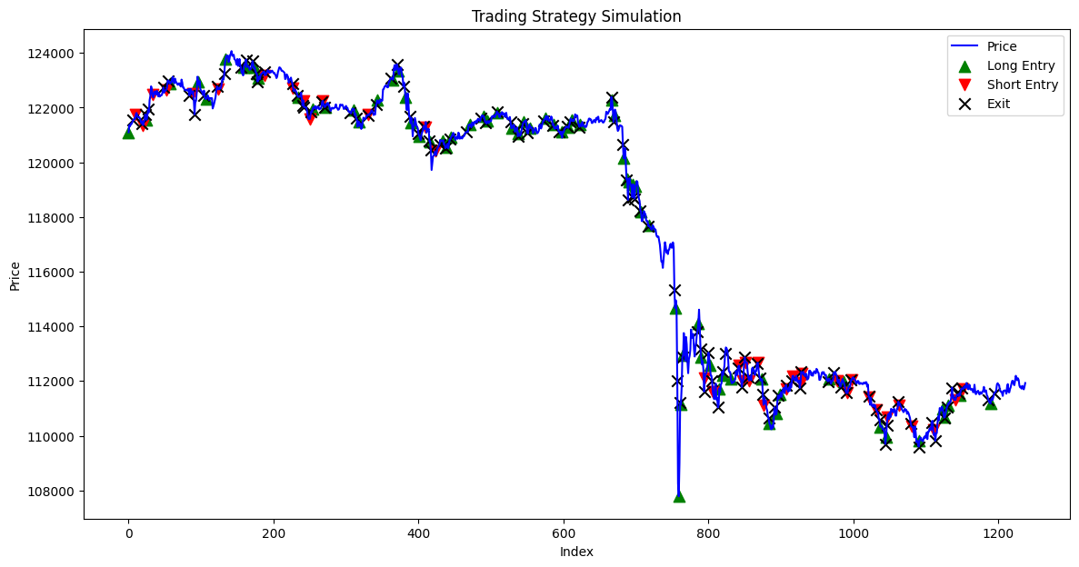
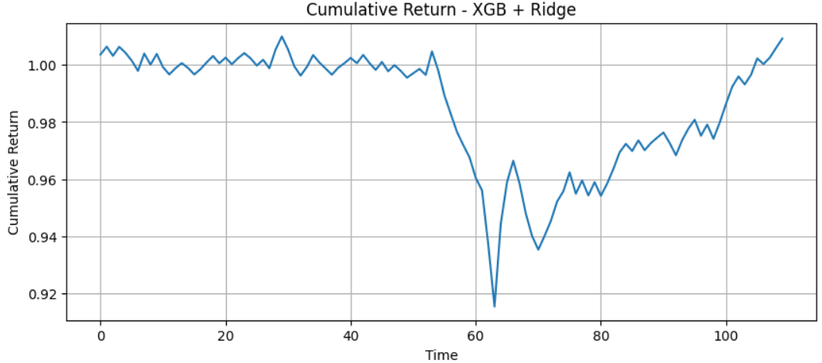
Results
XGB_Ridge Trading Strategy
IDA Template

Slide 40
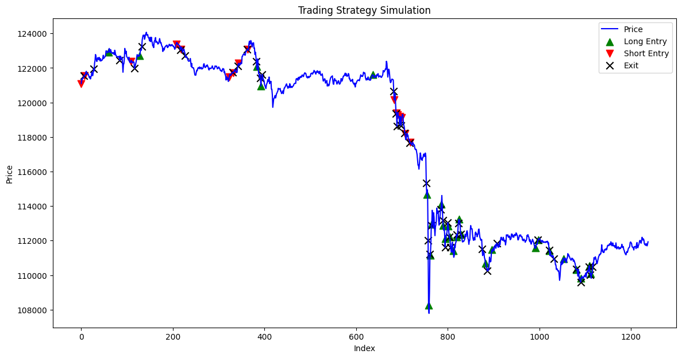
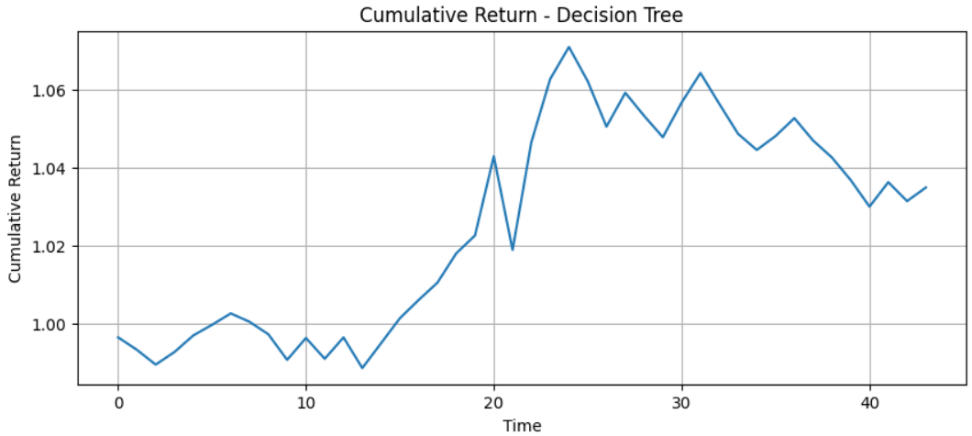
Results
DT Trading Strategy
IDA Template

Slide 41
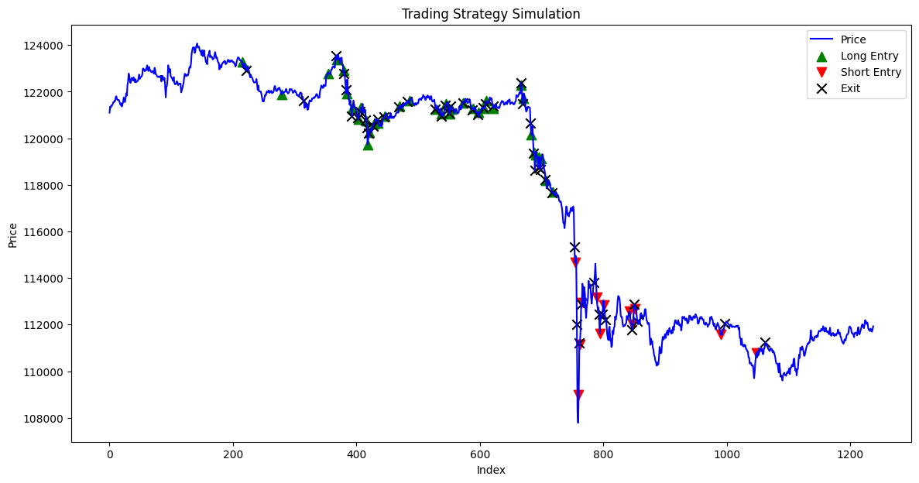
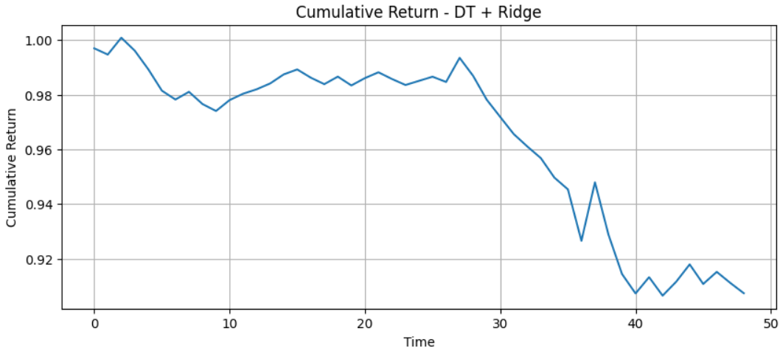
Results
DT_Ridge Trading Strategy
IDA Template

Slide 42
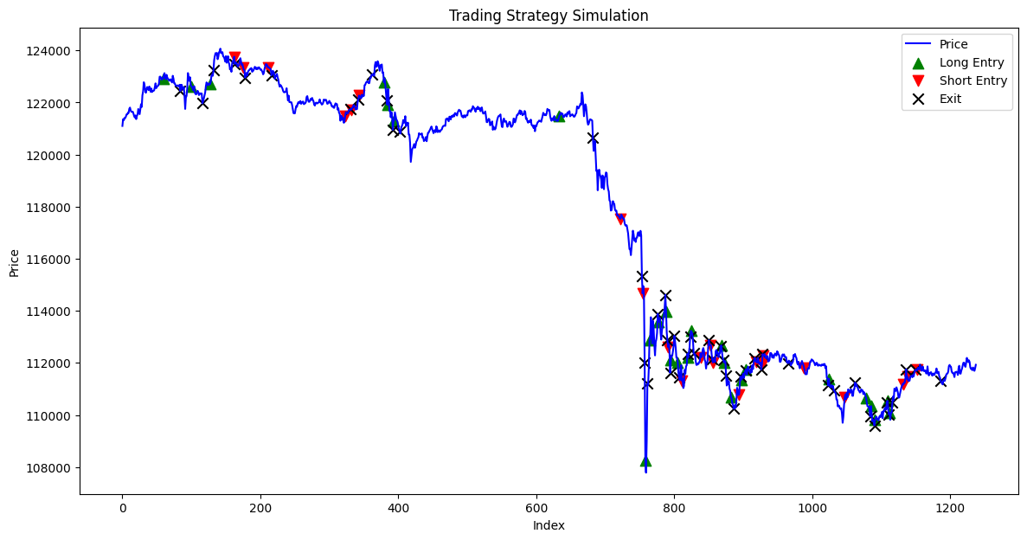
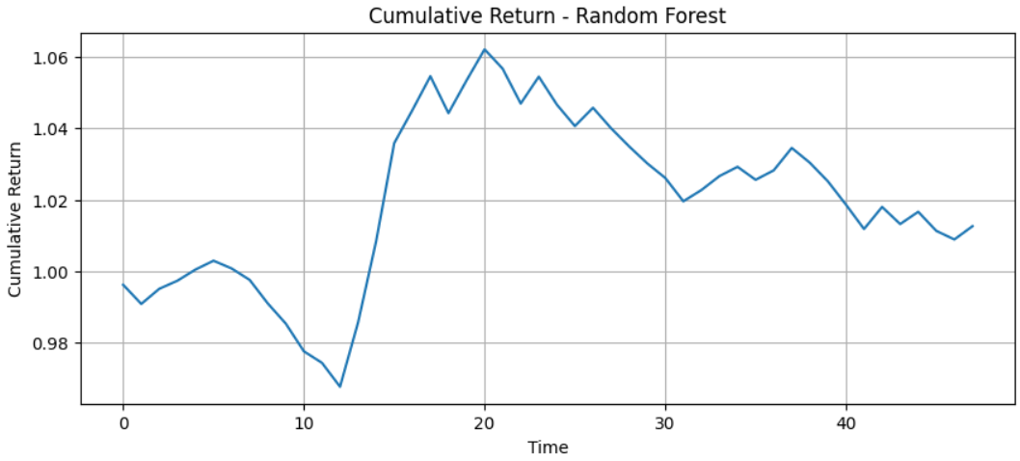
Results
RF Trading Strategy
IDA Template

Slide 43
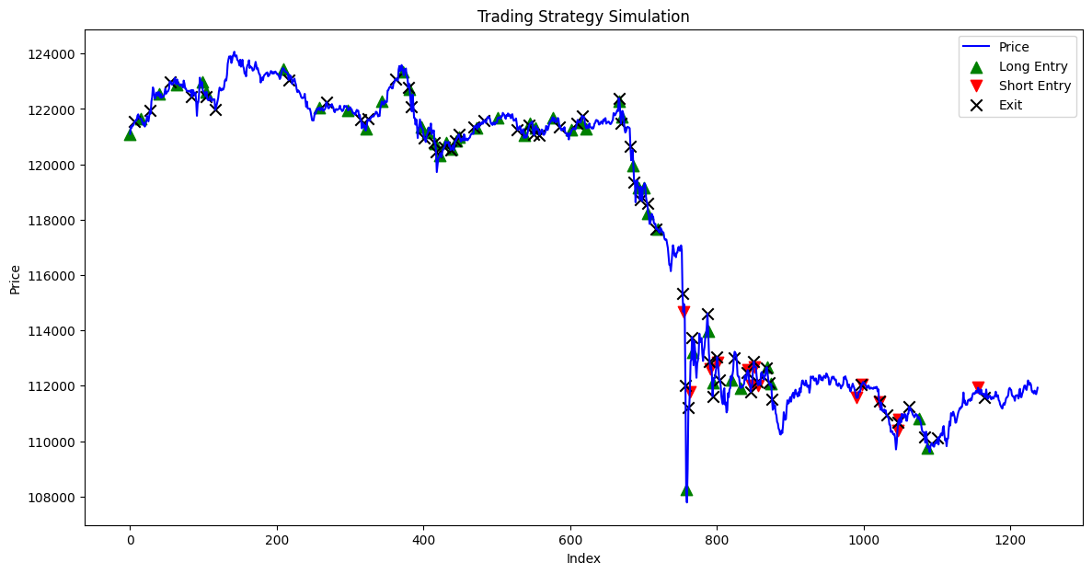
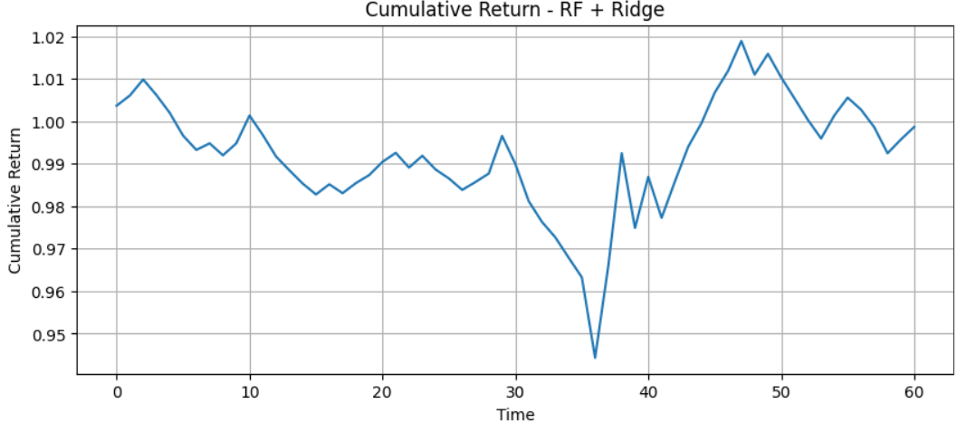
Results
RF_Ridge Trading Strategy
IDA Template

Slide 44
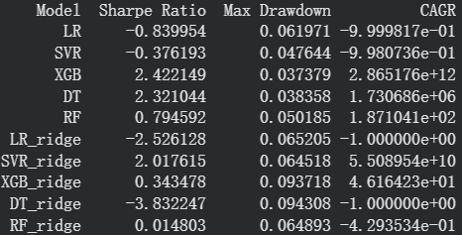
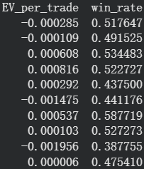
Results
Performance Comparison Across Models
XGBoost without rigde has the best Sharpe Ratio:2.422149
XGBoost without rigde has the lowest Max Drawdown = 0.037379
XGBoost without rigde has the best CAGR = 2.8651e+12
Decision tree without rigde has the best EV per trade : 0.000816
SVR with ridge has the best Highest win : 58.7719%
Overall, XGBoost wins! Also, it’s better to keep all the features.
All machine learning models outperformed linear regression model.
IDA Template

